Slide 1
Data Visualization: Session 1
21 March 2018
Laurel Brehm
MPI / IMPRS

Slide 2
Overview
A brief intro to visual perception
How does it work?
And how can it go wrong?
Themes of good & bad visualizations
Priming intuitions via experience & example
Break
Plotting as storytelling
What plots are there? How to use to convey the *right* info?
(Brief intro to the Tidyverse)

Slide 3
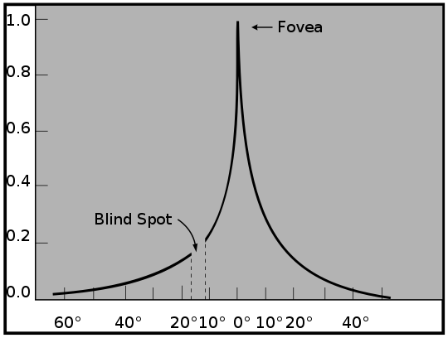
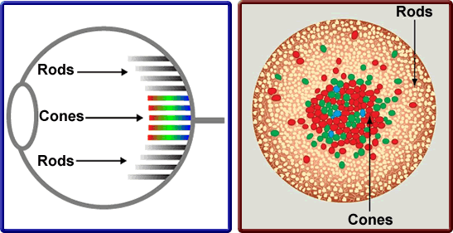
The visual system: Retina
http://digikalla.info/cones-and-rods/cones-and-rods-color-temperature-and-blue-light-iris-ideas/
Light enters eye
Lands on two types of light receptor cells:
rods (sensitive to contrast)
cones (sensitive to color)
https://en.wikipedia.org/wiki/File:AcuityHumanEye.jpg
Purves, Neuroscience

Slide 4
The visual system: Retina
http://digikalla.info/cones-and-rods/cones-and-rods-color-temperature-and-blue-light-iris-ideas/
https://en.wikipedia.org/wiki/File:AcuityHumanEye.jpg
Receptors are more tightly packed in fovea
5° of visual angle (=5cm at 1m length)
Highest acuity = 1-2° (=1-2 thumb widths at arm’s length)
Eye has blind spot just off from fovea
Purves, Neuroscience

Slide 5
The visual system: Retina
http://digikalla.info/cones-and-rods/cones-and-rods-color-temperature-and-blue-light-iris-ideas/
https://en.wikipedia.org/wiki/File:AcuityHumanEye.jpg
→Because of constraints of the retina,
we can only perceive a small area at a time
→ The brain is forced to fill in the details

Slide 6

Continuity is an illusion: Blind spots
Cover R eye & look at dot
At some distance from screen, + will disappear
Replaced with surrounding context (green field)

Slide 7
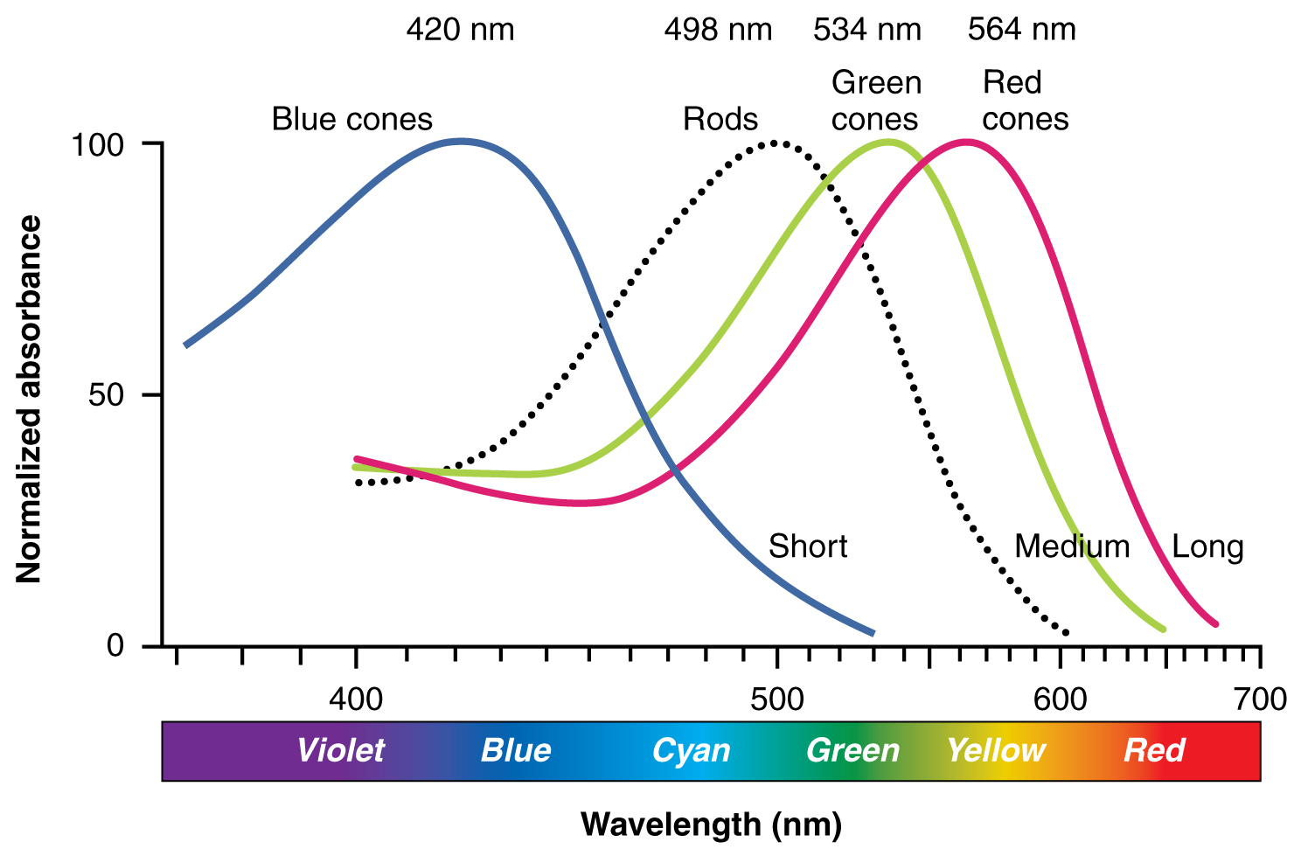
The visual system: Cones & Color
https://commons.wikimedia.org/wiki/File:1416_Color_Sensitivity.jpg
Color is perceived by combinations of light hitting cones
Typically: 3 cones, most sensitive to different wavelengths of light
Short (tritan) = 420 nm; Medium (deutran)= 534 nm; Long (protan) = 564 nm

Slide 8
The visual system: Cones & Color
https://commons.wikimedia.org/wiki/File:1416_Color_Sensitivity.jpg
Color is perceived by comparing activation on different receptors
Blue = lots of activation on S; little on M & L cones
Yellow = little activation on S; high activation on M & L cones

Slide 9
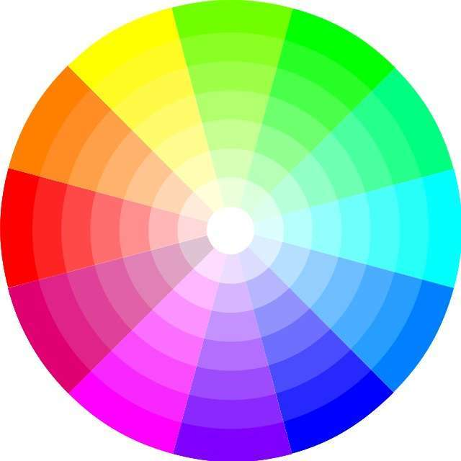
The visual system: Cones & Color
Additive color wheel
3 cones.. But light comes in lots of wavelengths
-Continuous spectrum from ultraviolet to infrared
-We only perceive some of them!
Though *light* is a linear spectrum, we perceive it on a continuous color wheel
-Opposite colors: red and cyan, blue and orange, green and magenta

Slide 10
The visual system: Cones & Color
Additive color wheel
What matters for color perception is how combinations of wavelengths sum to activate receptors
-“Pure” colors are perceived the same as combinations of colored light
-That’s how the color wheel wraps around: Magenta/purple only occur as a combination of wavelengths.
(One could argue that purple is a figment of the imagination)

Slide 11
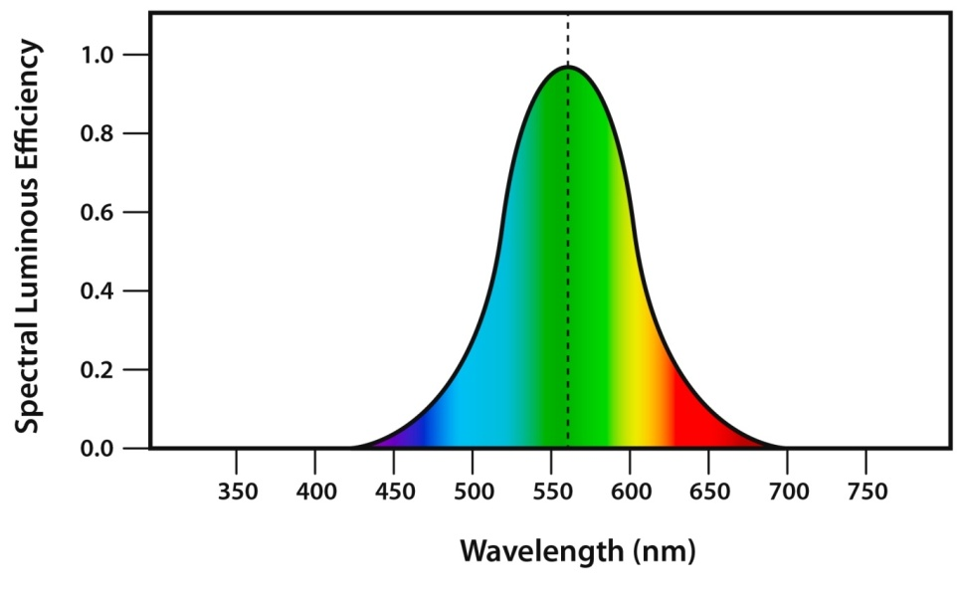
The visual system: Cones & Color
http://www.npl.co.uk/publications/good-practice-online-modules/optical-radiation-safety/the-human-eye-and-light/the-eyes-response-to-colour/
The fact that we have 3 cones (= a discrete receptor carving up a continuous space) means some colors are perceived better than others!
-Good at blue & green & yellow; terrible at violet

Slide 12
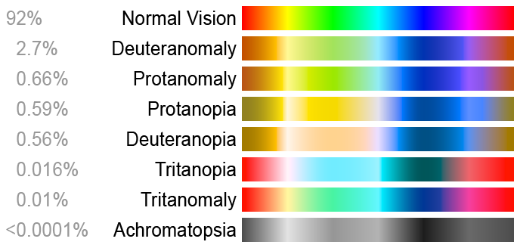
The visual system: Cones & Color
https://upload.wikimedia.org/wikipedia/commons/a/af/Color_blindness.png
Colorblindness is very common (1 in 12 people, more often men)
& occurs due to mutations in various cones
-Red-green colorblindness often occurs when cones mutated to be similar (protanomaly, deuteranomaly)

Slide 13
The visual system: Cones & Color
https://upload.wikimedia.org/wikipedia/commons/a/af/Color_blindness.png
Colorblindness is very common (1 in 12 people, more often men)
& occurs due to mutations in various cones
-Colorblindness also occurs due to cone being non-functional (red-green colorblindness: protanopia, deuteranopia; blue-yellow colorblindness: tritanopia)

Slide 14
The visual system: Cones & Color
→Color is not effortless.
Some contrasts are easier to make than others.
Spectral differences != perceptual differences
… in ANYONE, nonetheless people with colorblindness

Slide 15
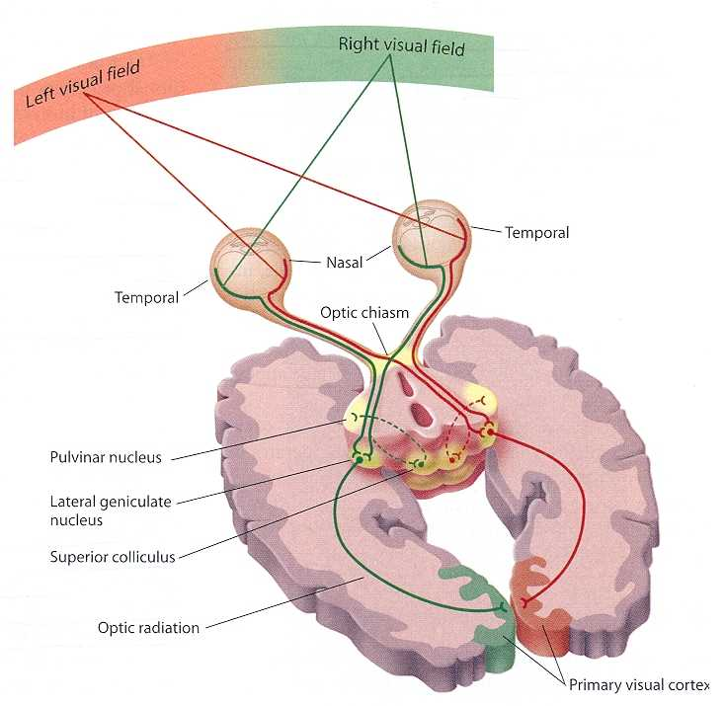
The visual system: Eye to brain
-Left and right visual fields processed with separate fiber bundles
-These cross at optic chiasm & go through brainstem to occipital lobe
Visual fields are mirrored in the brain (like motor control!)
-Older brainstem visual pathway:
Pulvinar / LGN / Superior colliculus
Preservation leads to blindsight
http://www.edoctoronline.com/medical-atlas.asp?c=4&id=21964&m=1&p=7&cid=1060&s=

Slide 16
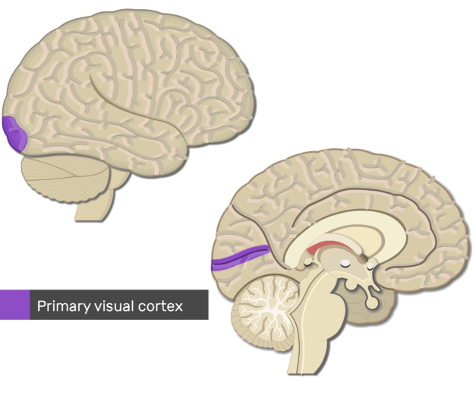
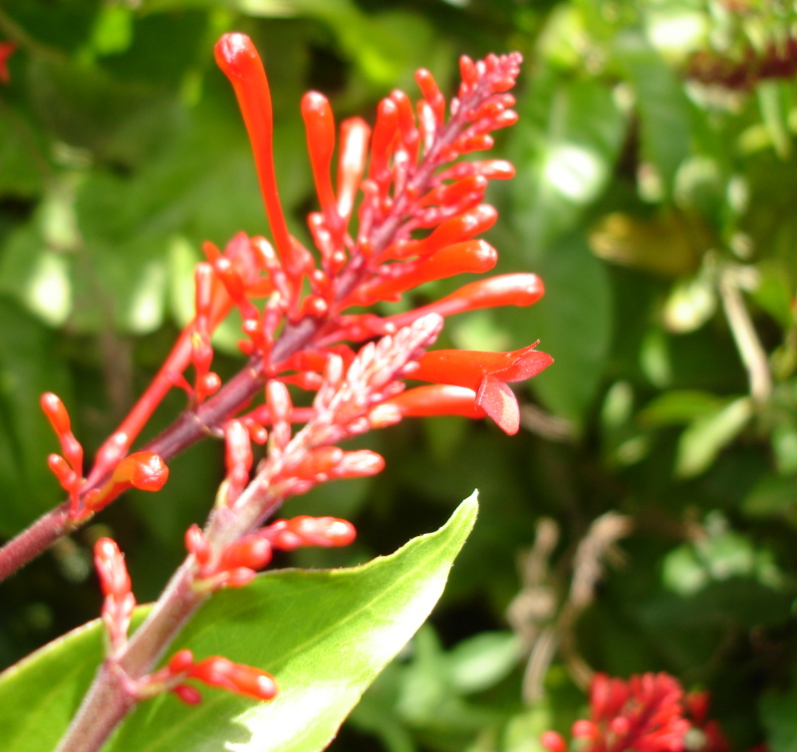
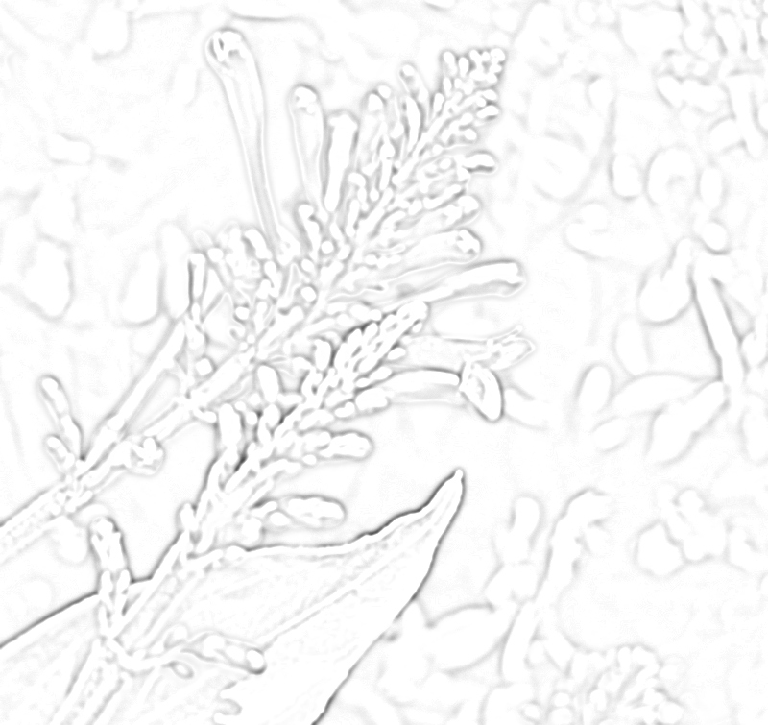
The visual system: Primary Visual Cortex
V1 = 1st primary visual processing area
-Topologically equivalent to layout of visual field
Fovea = most processing space
-Highly sensitive to contrast
‘Edge detector’
~difference of Gaussians (DoG)
-Also sensitive to local motion
https://www.getbodysmart.com/the-brain/visual-cortex-areas
https://en.wikipedia.org/wiki/Difference_of_Gaussians

Slide 17
The visual system: Primary Visual Cortex
→Light-dark contrast between adjacent regions is perceived EXTREMELY well

Slide 18
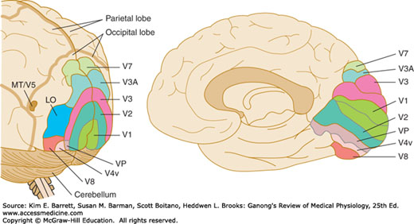
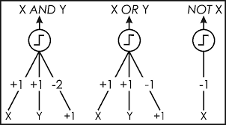
The visual system: V2 & V3
Moving ‘outward’ on visual cortex allows combinations of properties:
V2: Cells sensitive to single properties such as orientation, texture (/visual frequency), color
V3, V3a: Bigger, more complex patterns
-Cortex is still topographically oriented
Increasing complexity from V1 to V3: Like logic gates or layers in connectionist model

Slide 19
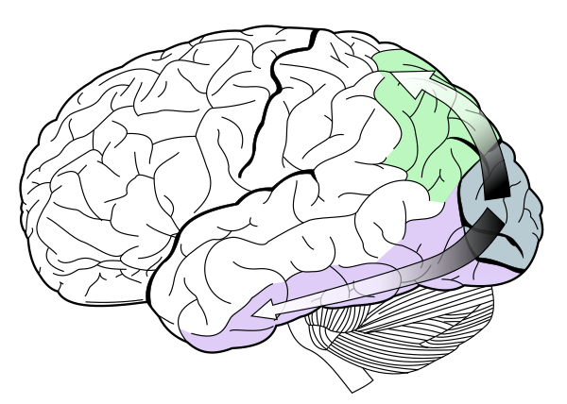
The visual system: Two visual streams
Dorsal = where
Vision for perception
Ventral = what
Vision for action
https://en.wikipedia.org/wiki/Two-streams_hypothesis
Milner & Goodale, 1995

Slide 20
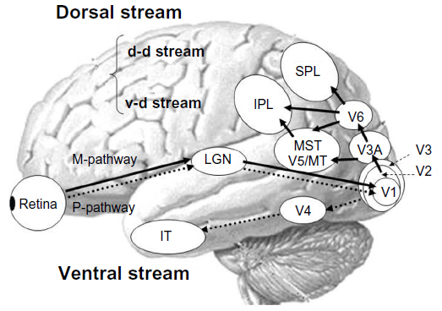
The visual system: Dorsal Stream
Where Pathway
Each step along the pathway integrates more parts of the visual field, and input from other parts of cortex (such as motor areas)
Extract & combine visual features:
V6 (DM): Visual search in topographically-oriented visual field
SPL/IPL: Vision in relation to body
Synthesize motion:
MT (V5): “Motion detector”
MT -> MST: More complex 3d motion / perception
Perry & Fallah, 2014 for beginner-friendly review
Fig from Yamasaki, Muranaka, Kaseda, Mimori, Tobimatsu (2011)

Slide 21
The visual system: Ventral Stream
What Pathway
As in dorsal stream, representation / percept is more complex along pathway
Activation heavily modulated by attention
Derive higher-order representation & interface with memory
V4: Cells sensitive to properties such as orientation, texture (/visual frequency), color & simple combinations of properties
IT: High-level representations, such as faces, places.
Perry & Fallah, 2014 for beginner-friendly review
Fig from Yamasaki, Muranaka, Kaseda, Mimori, Tobimatsu (2011)

Slide 22
The visual system: Two visual streams
As a principle of pathways:
→Combinations of features are hard to perceive simultaneously
→Shape, orientation are more primitive.
→Relations require more processing.
As a result of two streams:
→Some aspects of processing (roughly, where & what) don’t directly interact
Milner & Goodale, 1995

Slide 23
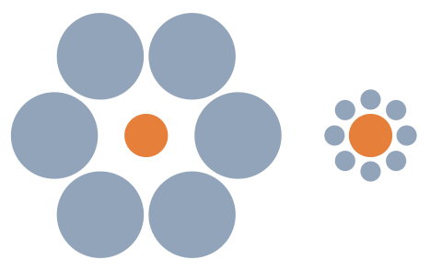
Illusions from processing in context
Ebbinghaus Illusion:
Size is relative

Slide 24
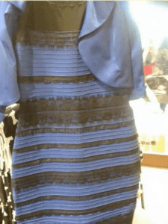
Illusions from processing in context
Ebbinghaus Illusion:
Size is relative
“The dress”: Color is relative & influenced by frequently-perceived hues

Slide 25
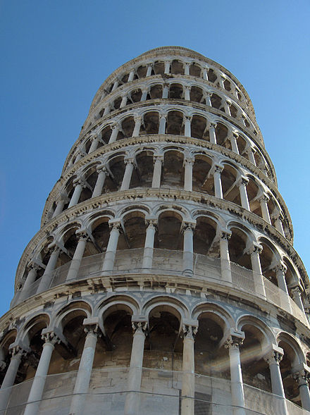
Illusions from processing in context
Ebbinghaus Illusion:
Size is relative
“The dress”: Color is relative & influenced by frequently-perceived hues
Leaning tower illusion:
Expectation of perspective

Slide 26
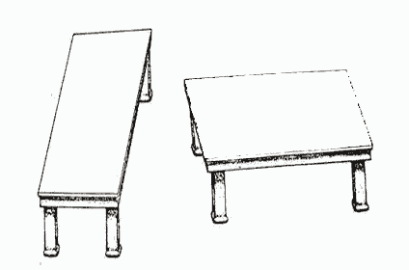
Illusions from processing in context
Ebbinghaus Illusion:
Size is relative
“The dress”: Color is relative & influenced by frequently-perceived hues
Leaning tower illusion:
Expectation of perspective
Shepard’s Tables:
Shape & size altered by depth

Slide 27
Illusions from processing in context
→ Area, color, shape, and size are influenced by perceptual factors & prior experience

Slide 28
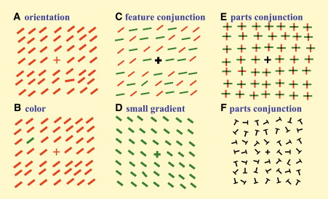
Vision & Attention
-Because vision & attention are both recruited for perception, some contrasts are easier than others
-Serial search (for conjunctions) vs pop-out
Triesman & Gelade, 1980; figure from Hochstein & Ahissar, 2002

Slide 29
Vision & Attention
→ONE THING is an easier contrast than two
Triesman & Gelade, 1980; figure from Hochstein & Ahissar, 2002

Slide 30
Dos and Don’ts from visual perception
Do | Don’t
Rely on stark contrasts (such as light versus dark) | Rely on hard to perceive contrasts (blue vs purple; red vs green)
Why: Primary visual cortex is good at contrasts
Present information directly with lines/shapes (scatterplot, line plot, violin) | Rely on relational information (such as bar plot / pie chart; relative areas)
Why: Primary visual cortex is good at single shapes/orientations
Use color strategically | Rely on complex color scheme (or a rainbow)
Why: Color perception is unreliable…but pop-out is automatic
Present as little as is necessary | Present too much information at once
Why: Multiple things exponentiate processing time
Use clear and simple labels | Mislabel or omit labels!
Why: Words can clarify confusion

Slide 31
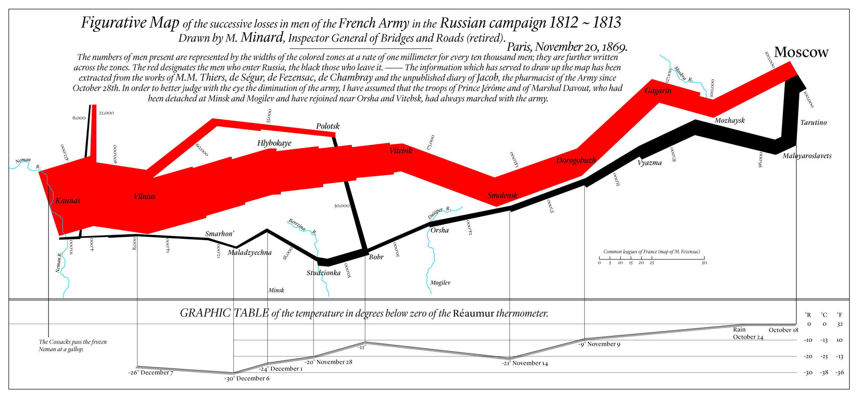
Good graphics
Minard map of Napolean’s defeat in Russia
-Clear use of size, shape, color, line
-Temperature laid out in a separate tier

Slide 32
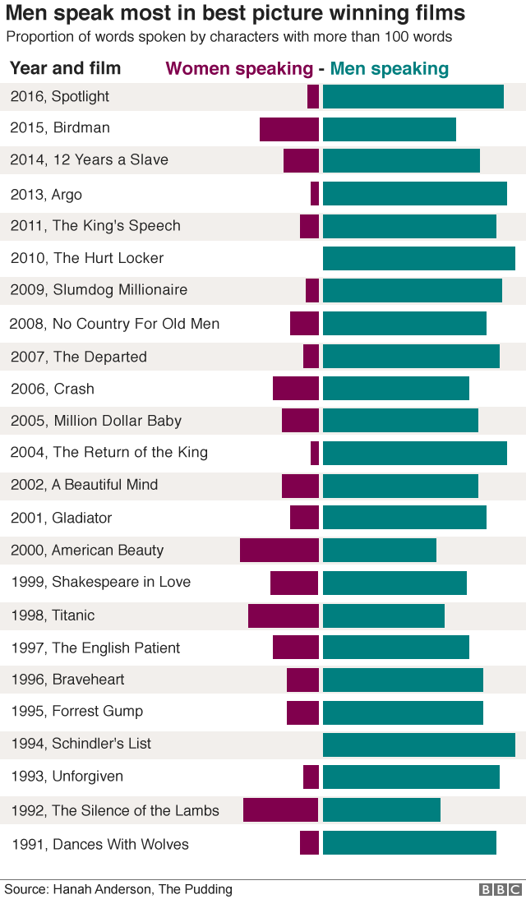
Good graphics
Plot of gender speaking in Oscar best-picture films
-Clear layout of words w/ bars
-Offset stacked bar very easy to get gestalt from
(=women don’t get speaking roles)
-And easy to see anomalies
(=war movies don’t have women in them)

Slide 33
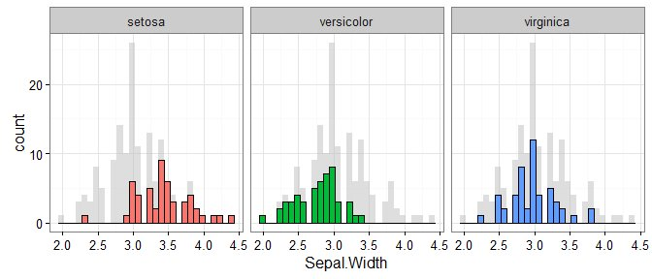
Good graphics
https://www.r-bloggers.com/plotting-background-data-for-groups-with-ggplot2/
Visualize condition distributions against greyed-out whole
-Easy to see how distributions change relative to whole
“Setosa” has widest sepals (& biggest sepal range)
=Make one comparison at a time

Slide 34
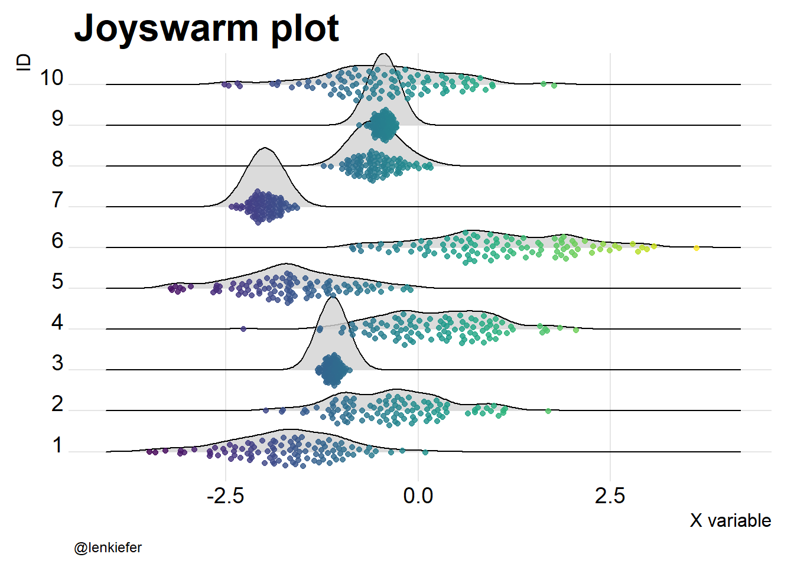
Good graphics
http://lenkiefer.com/2017/08/03/joyswarm/
Compare density plots (‘joyplot’) with overlaid data (‘beeswarm’)
-Color used to reinforce X-axis variability:
→ Conditions 9, 7, 3 are very different from 6
Uses Viridis palette (my favorite gradient scheme)

Slide 35
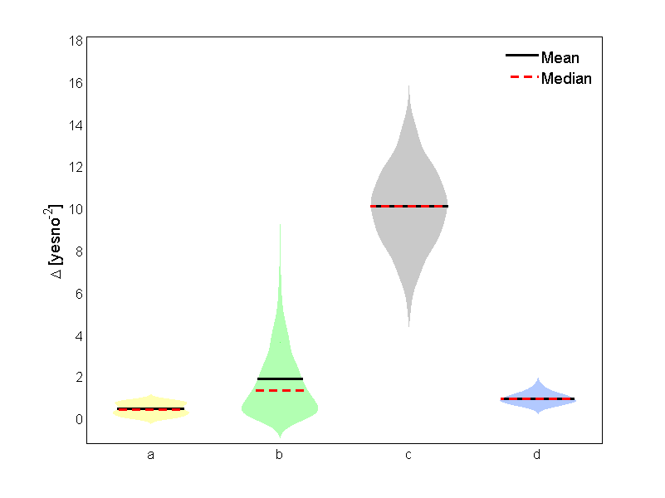
Good graphics
https://nl.mathworks.com/matlabcentral/fileexchange/45134-violin-plot?s_tid=gn_loc_drop
Violin plots with mean & median
=Condition C is very different
Easy to see distribution (if there are enough data!)
Colored so that the a, b, and d improvement on the scale are salient.

Slide 36
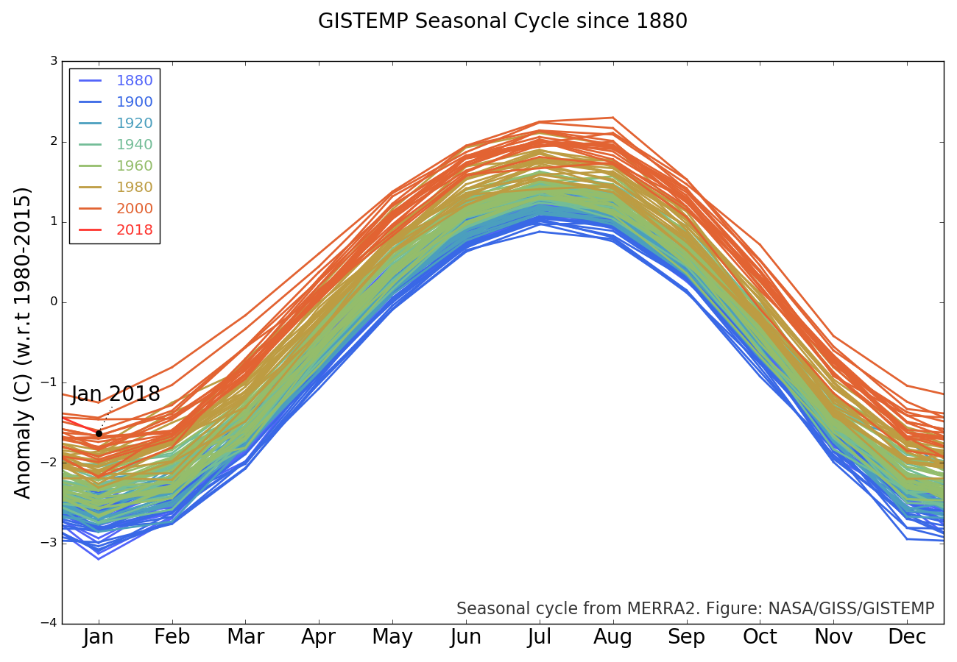
Good graphics
Line plot with colors over decades clearly shows trends
= The world is getting hotter
Helped by equal luminance color scale!
& mapping of red = hot

Slide 37
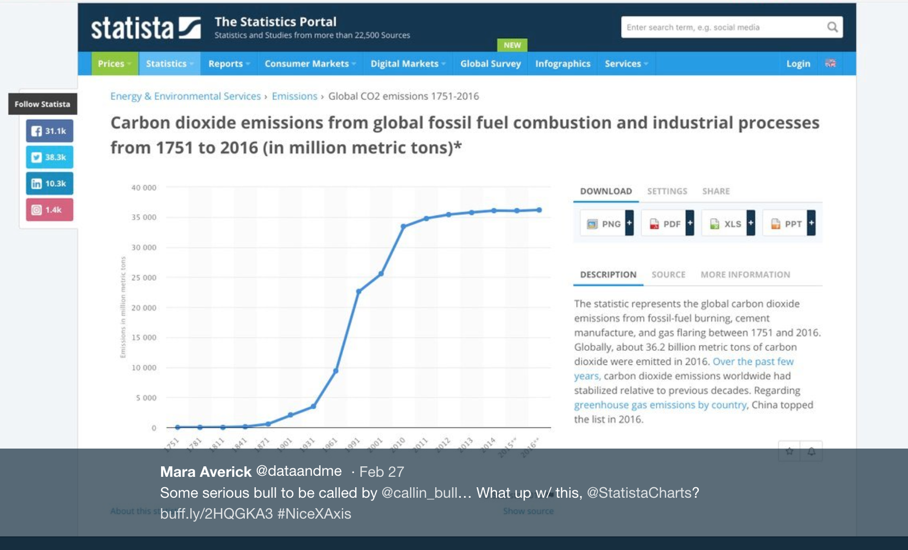
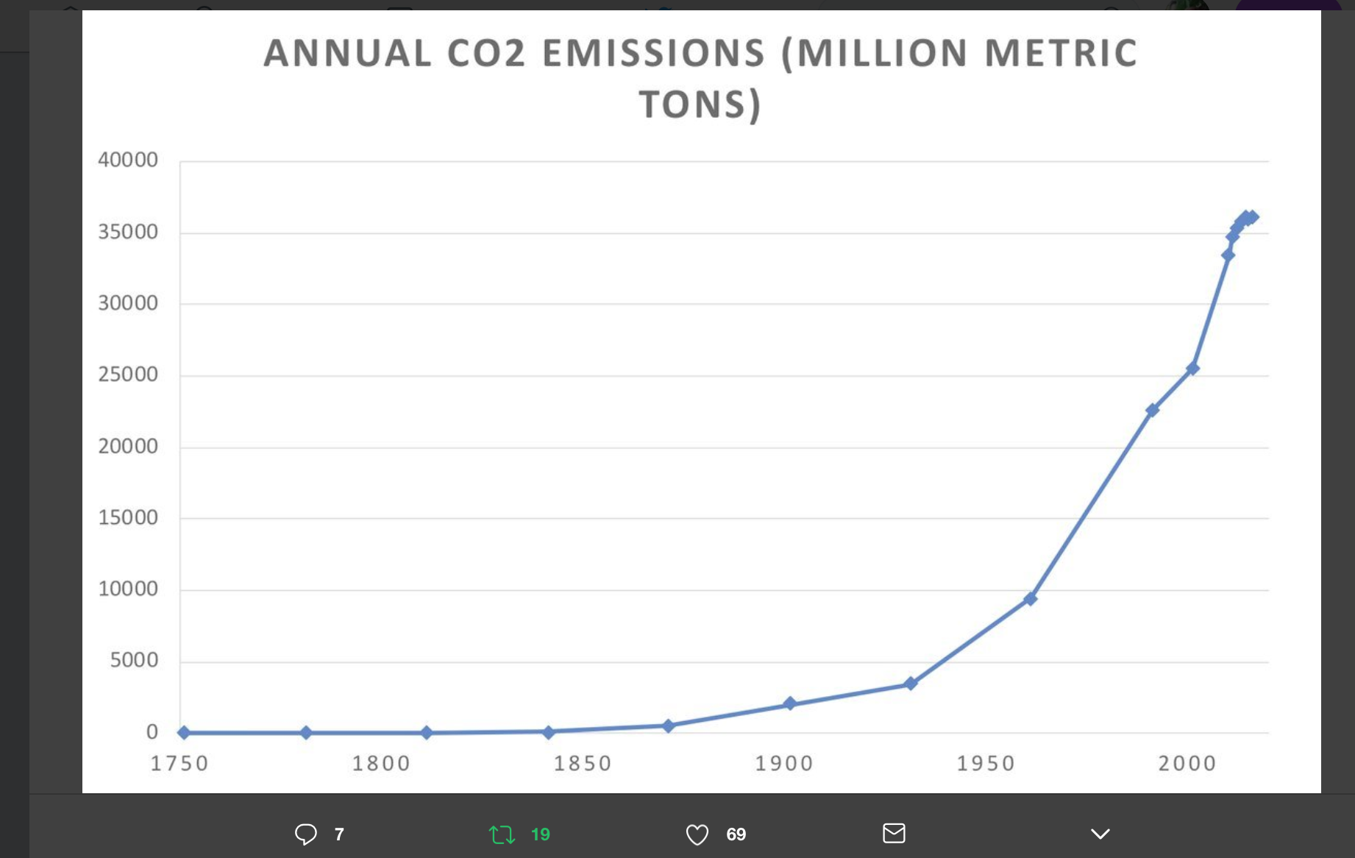
Bad graphics
Misleading scale (left) distorts actual trend (right)
→ Want to perceive distances as linear– but they aren’t

Slide 38
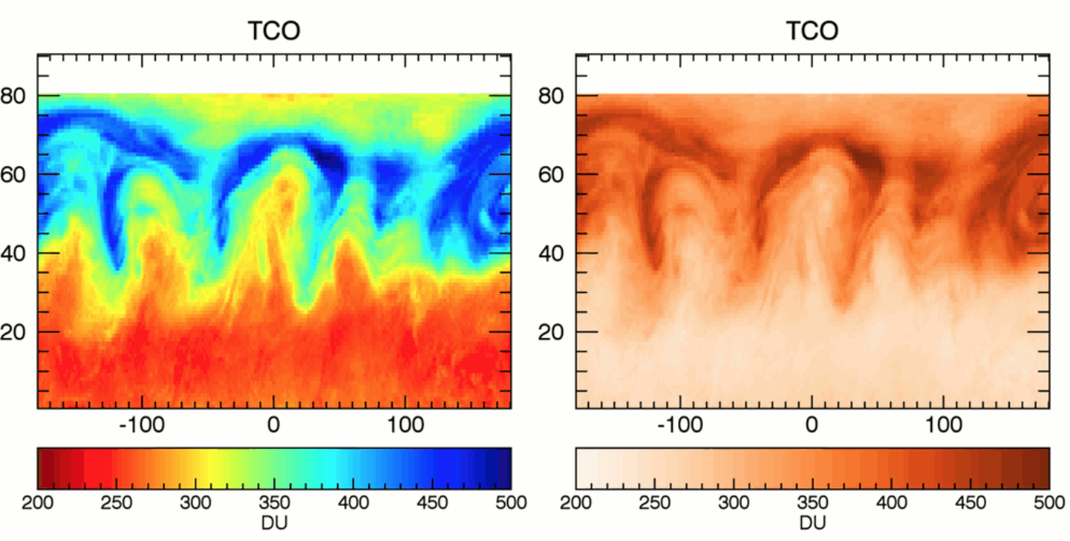
Bad graphics
https://www.climate-lab-book.ac.uk/2016/why-rainbow-colour-scales-can-be-misleading/
Use colors carefully!
-This color scale (in matlab, ‘jet’) is perceived categorically. Tend to see boundary that isn’t there (compare to right)
Color can mislead! Not all hues are perceived equally
Use equal luminance rainbow or viridis– not jet.

Slide 39
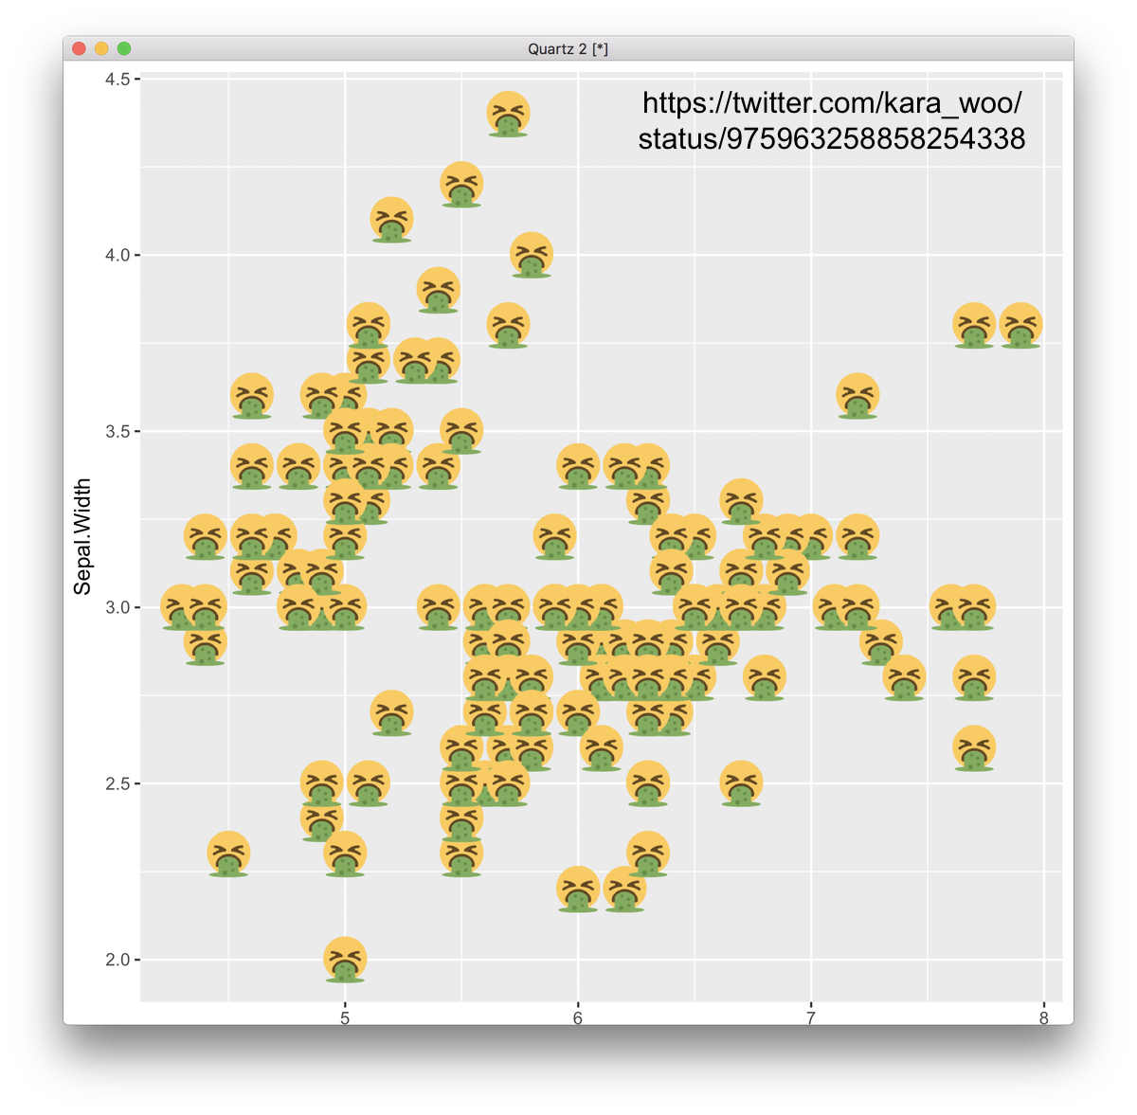
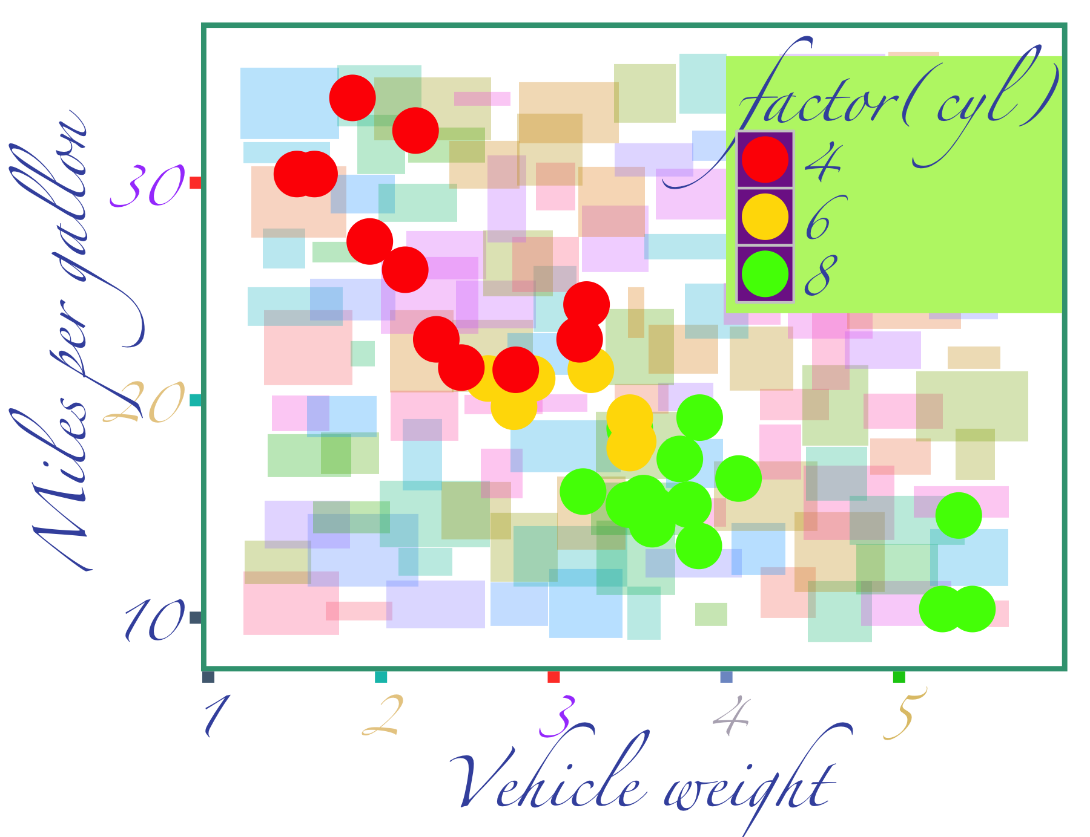
Bad graphics
https://gist.github.com/infotroph/93a45d8d54da5ad74696
Just because you *can* doesn’t mean you *should*
Keep it simple!
→ Visual clutter obfuscates

Slide 40
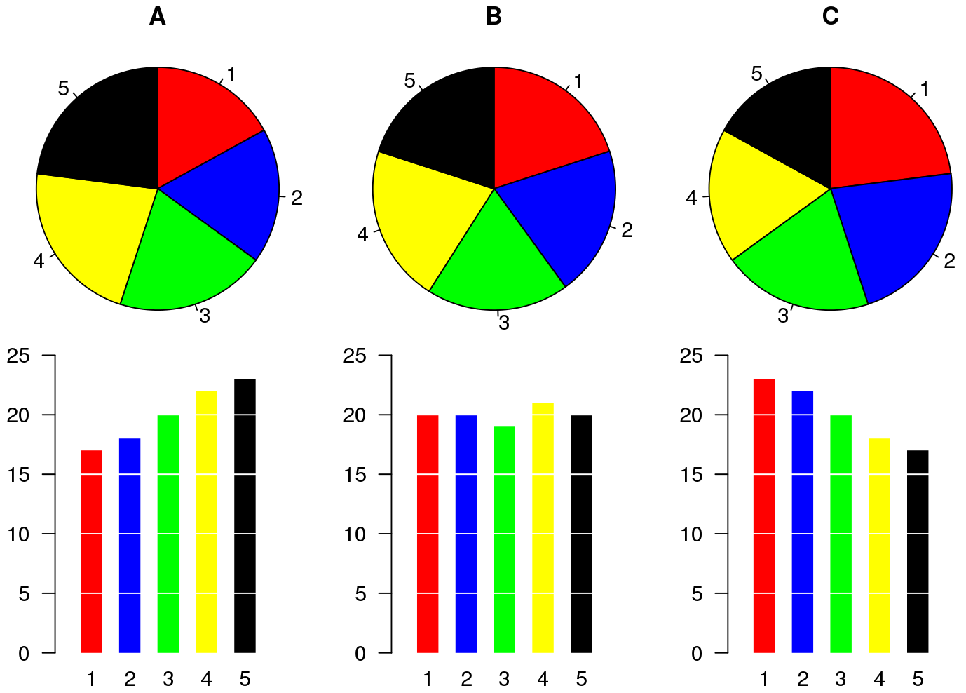
Bad graphics
https://commons.wikimedia.org/wiki/File:Piecharts.svg
Pie charts are nearly universally misleading
→ Size & area & orientation are relational (hard) comparisons

Slide 41
Bad graphics
This is a recreation of a bad graph that once was sent to me.
…Take a moment to think about your layout.
Setting up the display in the wrong way can ruin a perfectly acceptable plot!
And watch your labels! Avoid TGAs (totally gratuitous acronyms)

Slide 42
Sum-up
The eye is not a camera, and the visual system is not simple
Good visualizations capitalize on properties of what we’re good at!

Slide 43
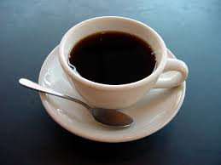
Break time

Slide 44
Types of plots
Here’s a nice & descriptive infographic with many plotting options:
ft.com/vocabulary
For our purposes, focus on graphs for:
-Correlation
-Time series (‘change over time’)
-Distribution
-Part-to-whole

Slide 45
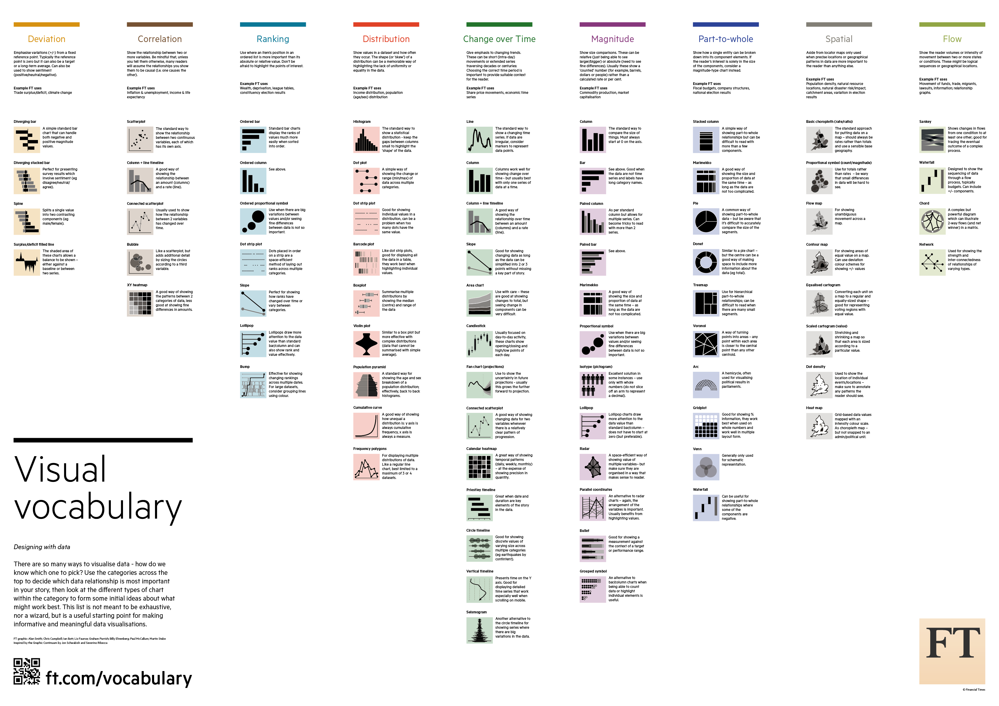

Slide 46
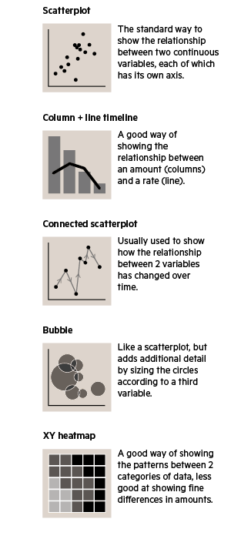
Correlation plots
These ask the question:
“How does Y change as a function of X”?
(Relationship between two or more linear variables)
-Can add a 3rd variable with color (heatmap) or size (bubble)
(But remember: these are inherently relational properties & hard to visualize over)

Slide 47
Correlation plots
Scatterplots are the canonical correlation plot example
Proportion of subject-verb errors varies continuously with conceptual number
Accompaniment The apple with the fresh peach
Attribute The phone with the missing button
Functional The check for the lawyers
Representational The drawing of the flowers
Brehm & Bock, 2013
Brehm, in prep

Slide 48
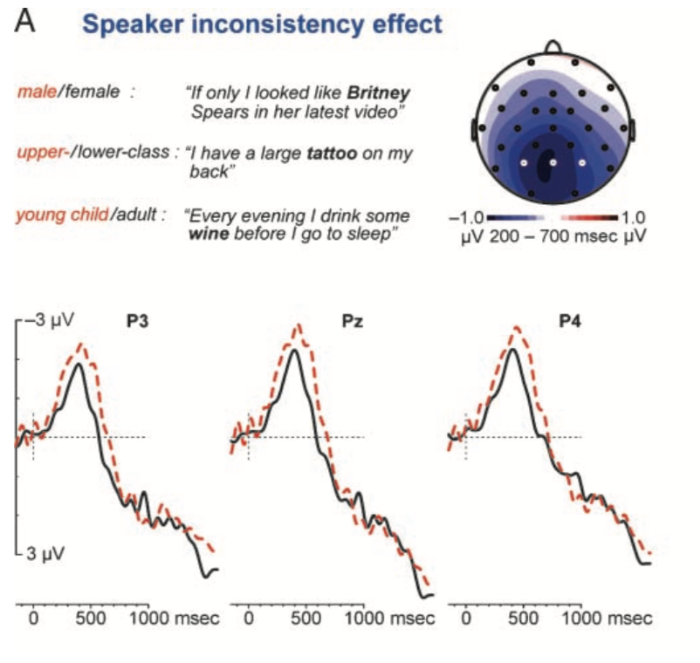
Heat maps
Z values across space!
Heat maps of brains
Van Berkum, JJA, Van den Brink, D., Tesink, CMJY, Kos, M., & Hagoort, P. (2008). The neural integration of speaker and message. Journal of Cognitive Neuroscience, 20 (4), 580-591. doi: 10.1162 / jocn.2008.20054.

Slide 49
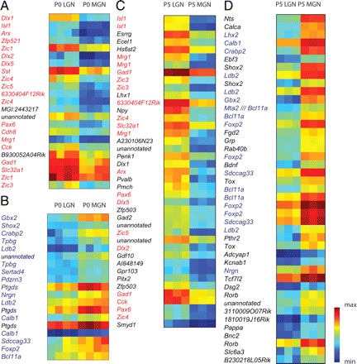
Heat maps
Z values across space!
Heat maps of genes!
Horng, S., Kreiman, G., Ellsworth, C., Page, D., Blank, M., Millen, K., & Sur, M. (2009). Differential gene expression in the developing lateral geniculate nucleus and medial geniculate nucleus reveals novel roles for Zic4 and Foxp2 in visual and auditory pathway development. Journal of Neuroscience, 29(43), 13672-13683.

Slide 50
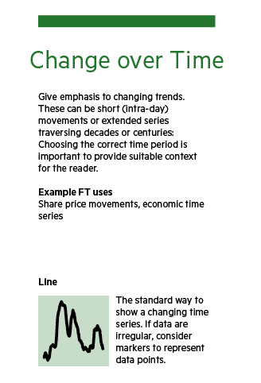
Time series
Asks the question “how does Y change over units of time X?”
Sort of a special case of the correlation plot
For our fields…
there are really just 2 options:
Use a line plot
Or points + smooth
(Like in my correlation plot example)

Slide 51
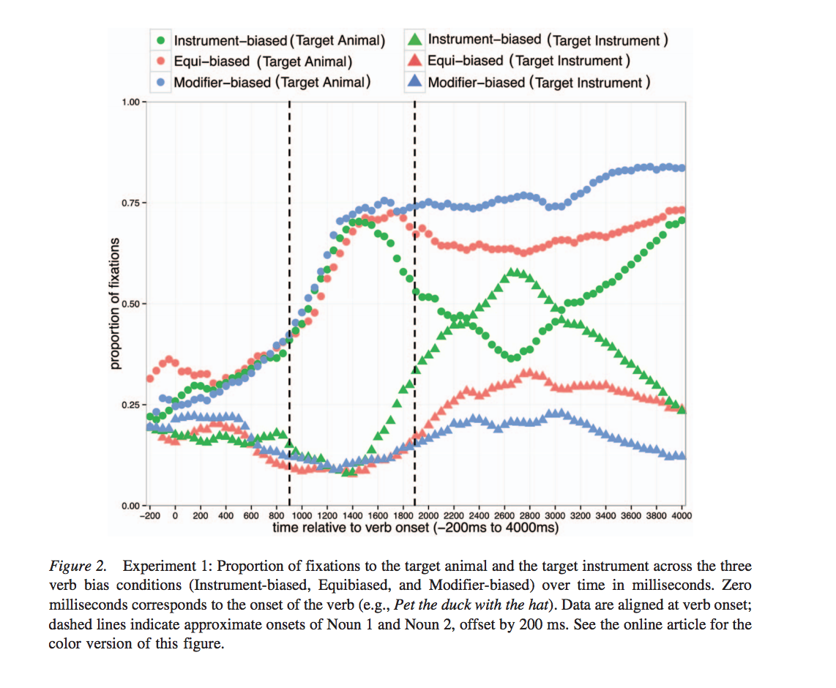
Time series
Eye-tracking “spaghetti” plots
Ryskin, R. A., Qi, Z., Duff, M. C., & Brown-Schmidt, S. (2016). Verb Biases Are Shaped Through Lifelong Learning. Journal of Experimental Psychology: Learning, Memory, and
Cognition.

Slide 52
Time series
Waveforms from ERP!
From Van Berkum et al again

Slide 53
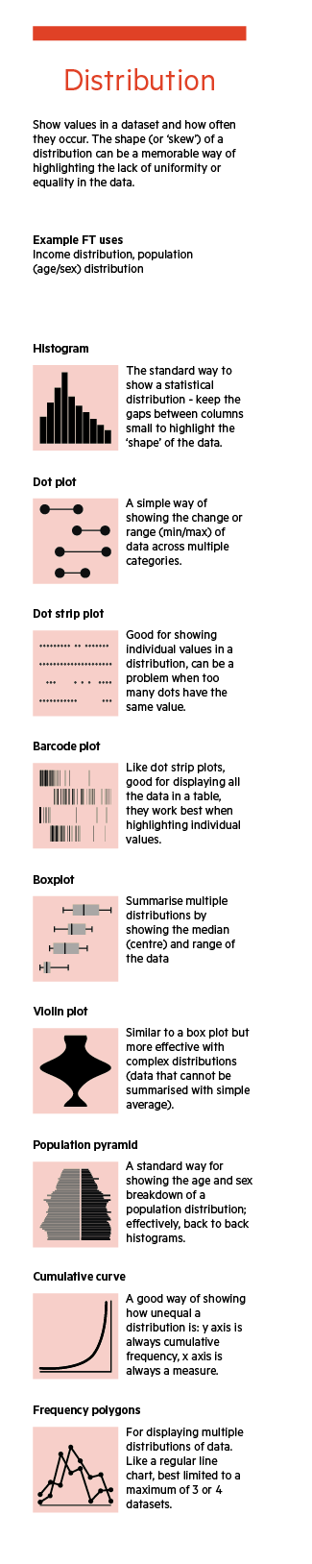
Distribution plots
Answer the question: “How does X affect the distribution of values of Y”
(This is often the question we ask statistically in psycholinguistics!)
Add to this:
-density plot (continuous histogram)
-joyplot (stacks of density plots)
(Dot strip plot = bee swarm plot)

Slide 54
Violin plots
Distribution of memory errors based upon study conditions in a picture naming task
Hybrid of a violin plot + 95% within-subject CI for means
From Zormpa et al, (2018)

Slide 55
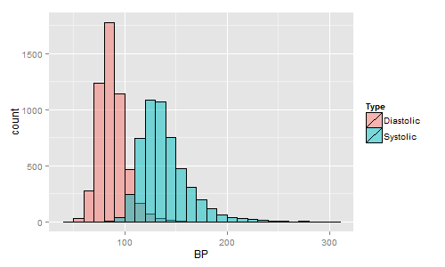
Histogram
Blood pressure observations (counts) at phase of heartbeat
(Note the nice use of transparency)
https://blogs.sas.com/content/graphicallyspeaking/2013/12/01/r-u-graphing-with-sas/#prettyPhoto

Slide 56
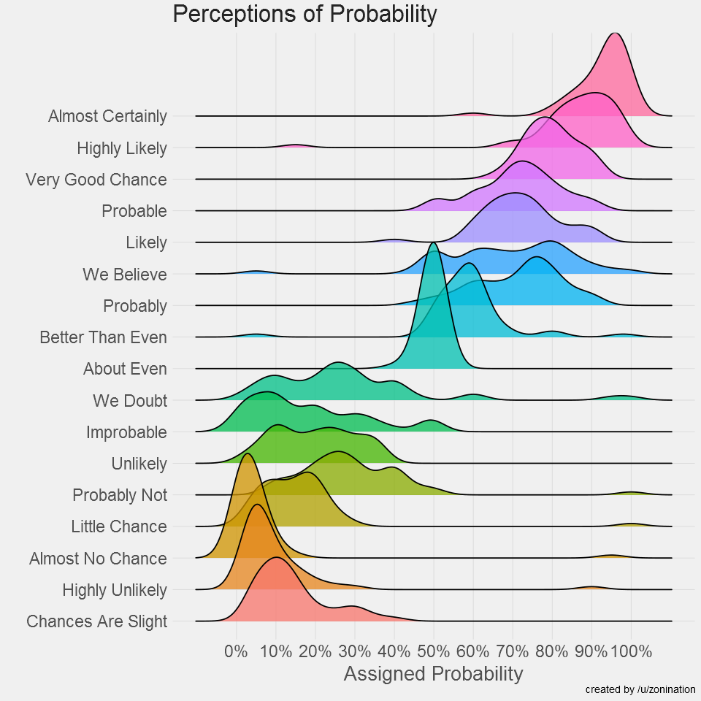
joyplot
How likely is something that is “probably” going to happen?
http://blog.revolutionanalytics.com/2017/08/probably-more-probably-than-probable.html

Slide 57
Contrasts between types of distribution plots
Violin plot + means is like a barplot but less misleading!
-Good for experimental-psych-y designs
-Like this 2x2 design replicated across 2 experiments
Ordered axis lends itself well to joyplot
-Directly compare adjacent curves
Histograms show the presence of the binning in your data
-Notion of precision Overplotted histograms are great for simple, direct comparisons where the overlap is informative

Slide 58
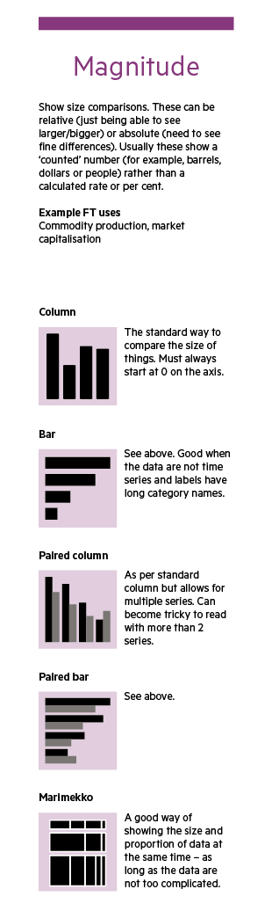
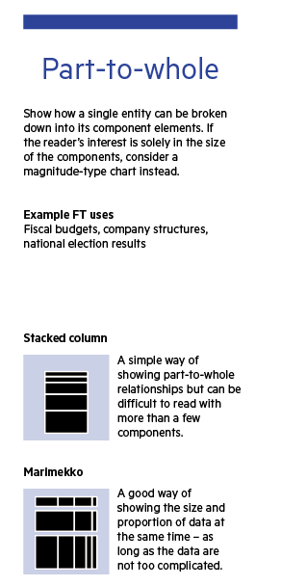
Magnitude & part-to-whole: Various Bar plots
Question:
“How does the value of Y change between categories of X”
(*Only* appropriate for categorical variables)
1. The good! Bar plots / stacked bar plots) are OK for proportion data
-Ok to hide nuances
-Fast and easy to process
2. The bad! Bar barplots

Slide 59
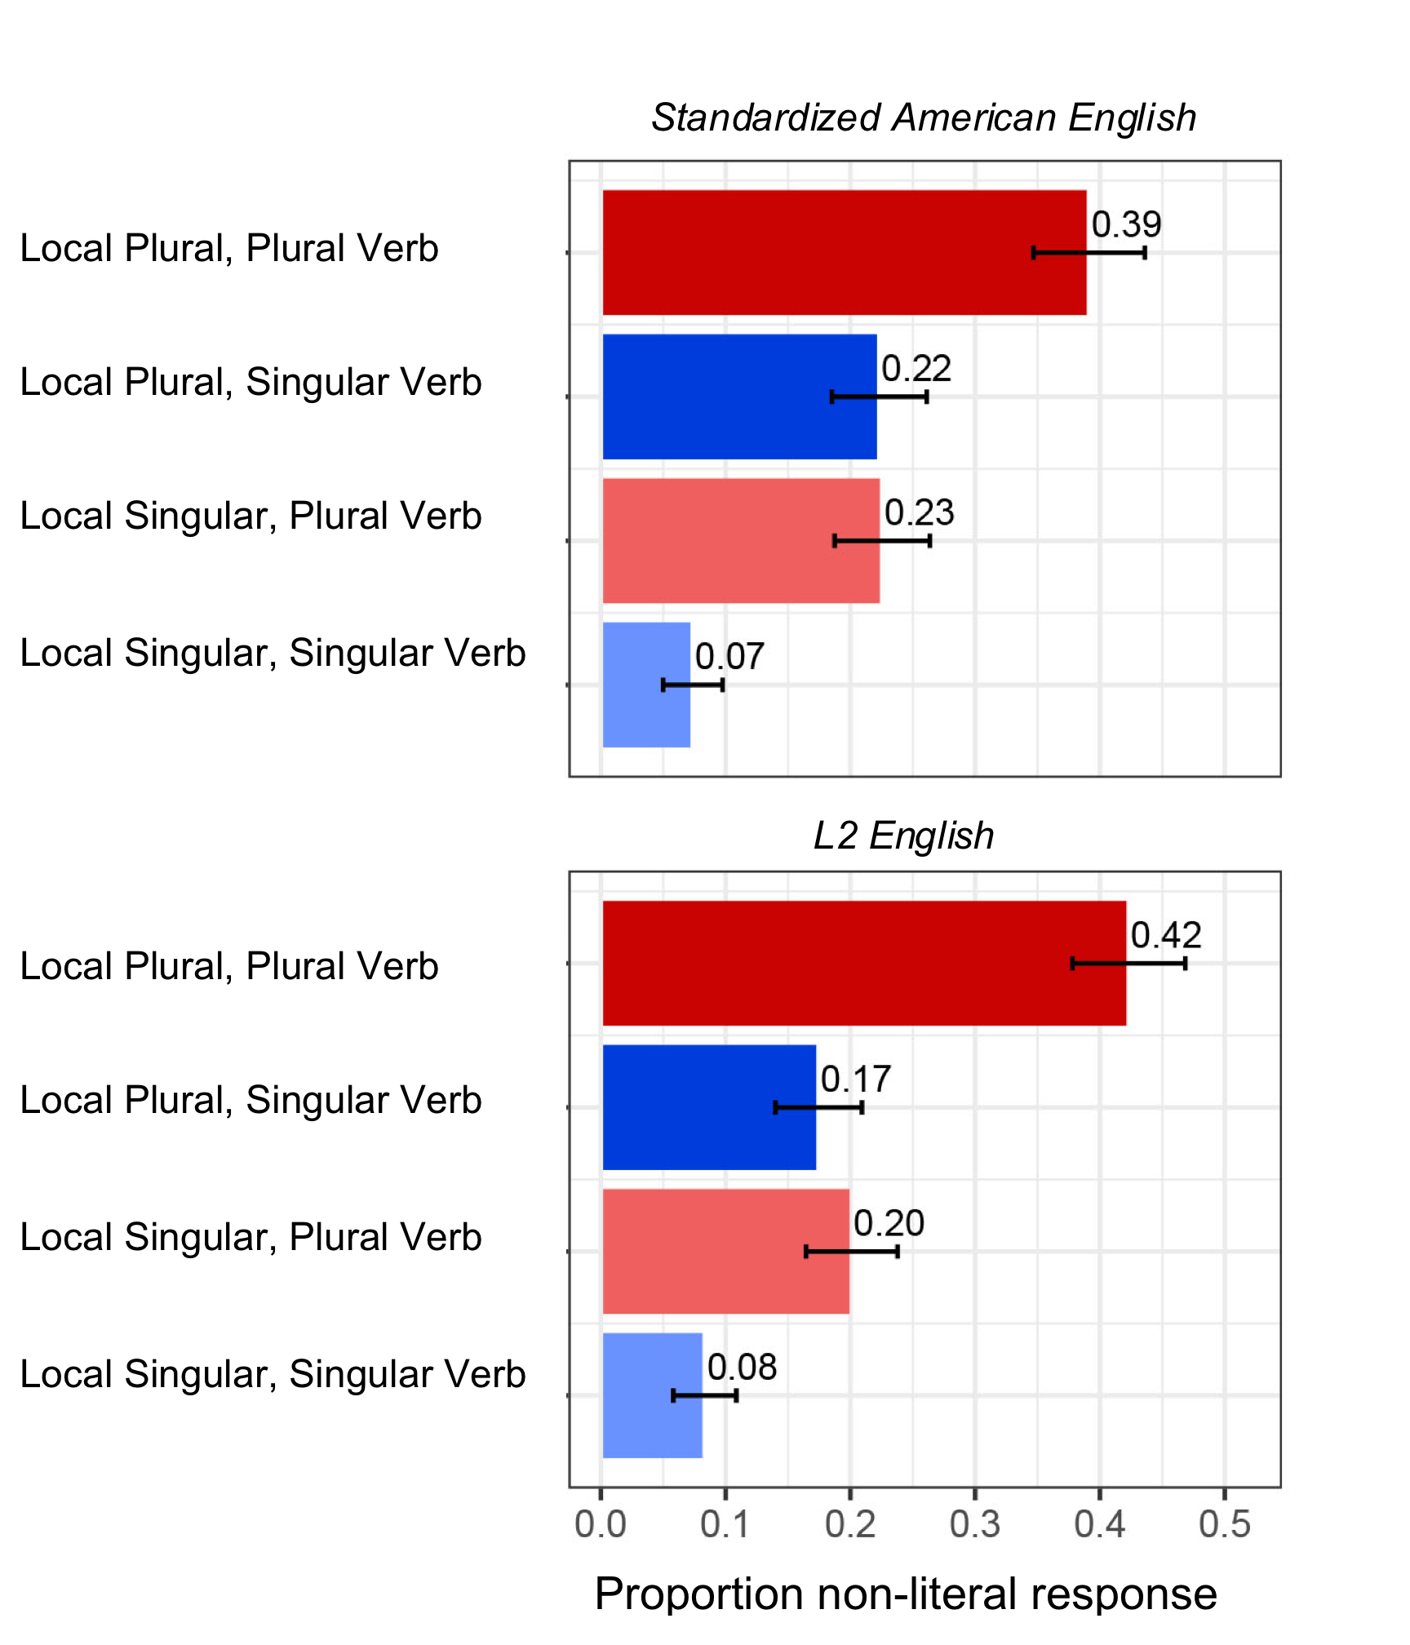
Bar plots are sometimes OK
For data where
-There is a meaningful zero value
-There are multiple comparisons
-Mean differences are small but statistically reliable
-Distributions are NORMAL
(Can assume proportions are normal, as they are Bernoulli trials)
A bar plot might actually be best.
This is from a paper of my own!
Brehm, L., Jackson, C., & Miller, K. (2018). Speaker-specific processing of anomalous sentences. Quarterly Journal of Experimental Psychology.
Figure 1. Agreement sentence interpretations for Experiment 1. Panels reflect sentences attributed to a Standardized American English speaker (top) and an L2 English speaker (bottom). Means by condition displayed next to bars; error bars reflect standard error around means.

Slide 60
But... bar plots can be misleading
Next 3 examples from Christina Bergman ☺
Our field is going through a reproducibility & transparency crisis
What does plotting have to do with all this?
Figures are what you remember of a story
Interpretations and conclusions rest on (misleading) figures

Slide 61
Bar bar plots
We are used to seeing thing like this! Oh look, a difference!!

Slide 62
Bar bar plots
But… hm. Adding a scale tells a different story.

Slide 63
Bar bar plots
→ Bar plots often encourage your visual system to tell the wrong story!

Slide 64
Bar bar plots
Simplifying to just means & standard deviations can *hide* important patterns

Slide 65
Bar bar plots
Simplifying to just means & standard deviations can *hide* important patterns

Slide 66
Bar bar plots
ALWAYS consider what your distribution looks like.
ALWAYS consider your research question.
Many research questions are really about changes in distributions across conditions
A variant of Anscombe’s quartet

Slide 67
Bar bar plots
ALWAYS consider what your distribution looks like.
ALWAYS consider your research question.
Many research questions are really about changes in distributions across conditions
A variant of Anscombe’s quartet

Slide 68
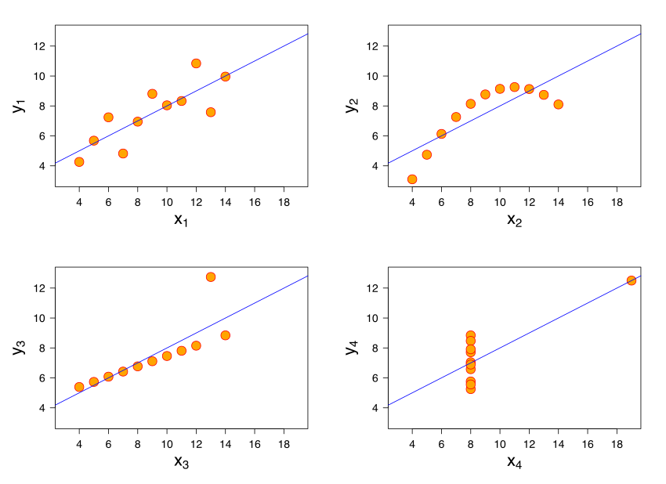
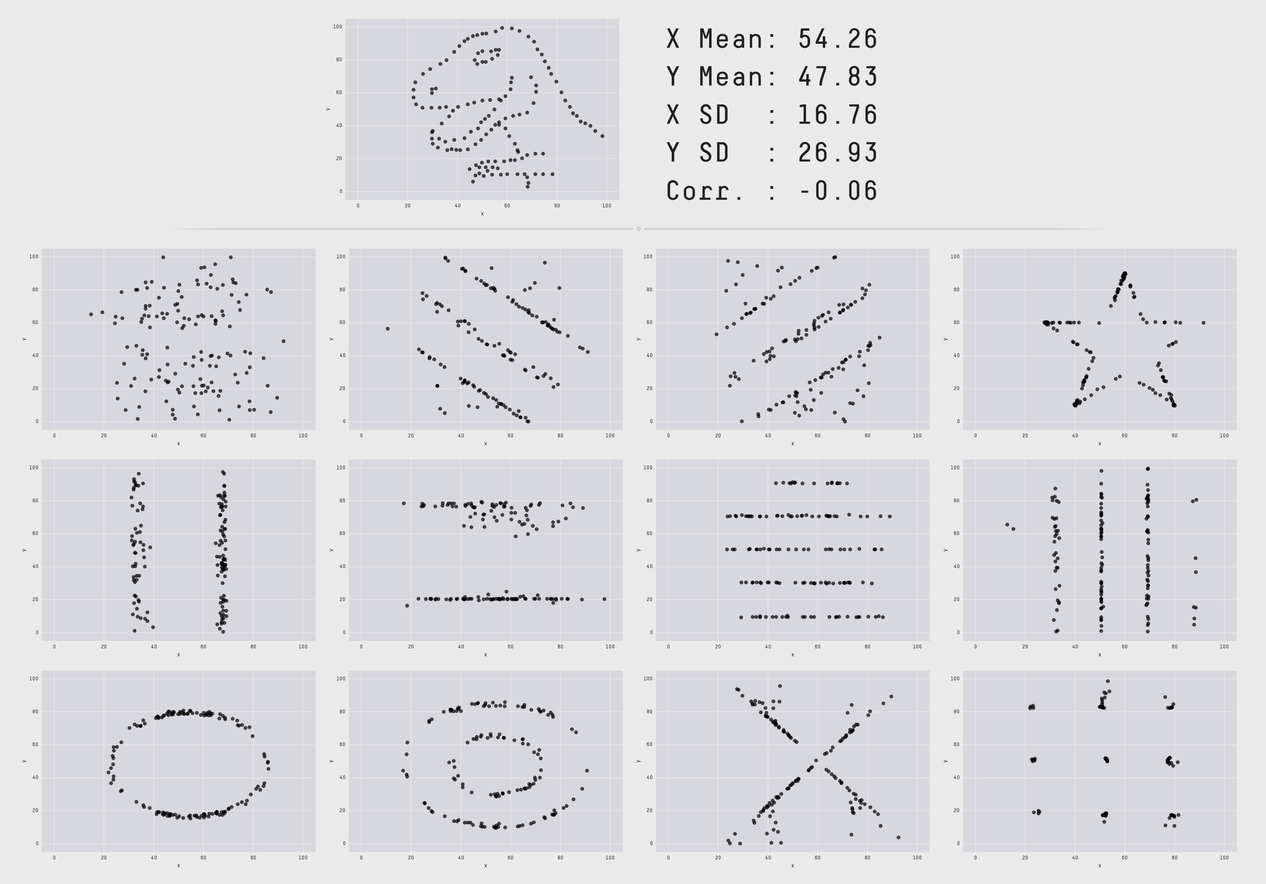
Bar bar plots
Showing the *actual* data where possible is informative.
Another variant of Anscombe’s quartet
https://en.wikipedia.org/wiki/Anscombe%27s_quartet
Cairo’s Datasaurus
https://www.autodeskresearch.com/publications/samestats

Slide 69
Bar bar plots
Summary
While bar plots are useful for some types of information, they, by definition, simplify the data
Consider if an alternate plot type is available
And if so... Please use it.

Slide 70
What plot to choose? The plot changes the story
Worked examples from Baayen’s available lexdec data set
Word & non-word lexical decision times based upon a variety of participant and item-level variables
library(languageR)
data(lexdec)

Slide 71
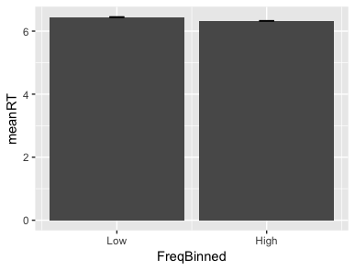
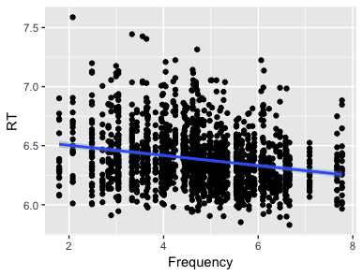
Lexical decision RT predicted by word frequency
Simple, but including 0 minimizes true effect size
Scatterplot w smooth gives sense of variability… wonder what else matters?

Slide 72
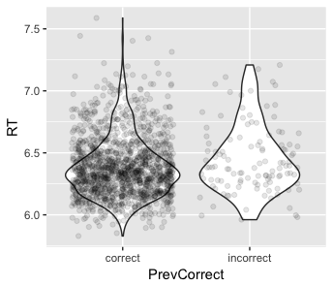
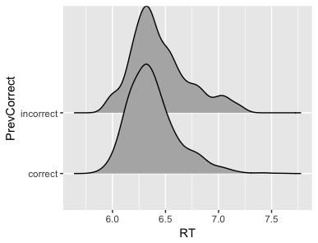

Lexical decision RT predicted by previous answer
Different plots tell different stories

Slide 73



Lexical decision RT predicted by word length
Different plots tell different stories

Slide 74
Sum-up
There are many right answers! (and also many wrong ones)
Play with multiple options!
Portray variability when you can, but also tell a clear story
Use greyscale, alter alphas, add trend-lines, other ‘shorthands’
Adding points is a great way to show variability, but sometimes can overwhelm the reader
When in doubt: Default to a density plot or a violin.

Slide 75
Tidyverse
Taken directly from
https://dplyr.tidyverse.org/
Relevant packages
Library(dplyr)
Library(tidyverse)

Slide 76

Extremely basic R
SCRIPT FILE: a text file I can run in R
ENVIRONMENT (shows what I have loaded in)
CONSOLE
OTHER STUFF: plots

Slide 77
Extremely basic R: scripts & packages
Save your work in a *script* file
This is a plain text or .R file you can run script chunks from to create plots
Within your scripts, you can access
Base R: all the basic math functions in-build to R
Packages: cool things other people developed & shared

Slide 78
Installing and loading packages
To be able to use a package, you have to download & install it from the internet:
You’ll do this only once
install.package(‘tidyverse’)
Then, you load it up into R
You can set things to load automatically, or you can run this code at the beginning of your script
library(tidyverse)

Slide 79
Tidyverse & ggplot
The plotting functions I used to create some of the plots today came from ggplot
The guy who developed these functions also has some useful data management / tabulating functions that we’ll walk through today
The hope is that even if you haven’t ever used R, you’ll be on an even footing next week with everybody else

Slide 80
Tidyverse & ggplot
The next few slides come directly from https://dplyr.tidyverse.org/

Slide 81
Tidyverse: Overview
dplyr is a grammar of data manipulation, providing a consistent set of verbs that help you solve the most common data manipulation challenges:
• mutate() adds new variables that are functions of existing variables
• select() picks variables based on their names.
• filter() picks cases based on their values.
• summarise() reduces multiple values down to a single summary.
• arrange() changes the ordering of the rows.
These all combine naturally with group_by() which allows you to perform any operation “by group”. You can learn more about them in vignette("dplyr").

Slide 82
Tidyverse: Displaying data subsets!
Syntax uses a %>% ‘pipe’ notation to pass objects to functions.
Here, we are looking in the dataframe ‘starwars’, and asking it to filter out only the data where species is Droid
library(dplyr)
starwars %>%
filter(species == "Droid")
#> # A tibble: 5 x 13
#> name height mass hair_color skin_color eye_color birth_year gender
#> <chr> <int> <dbl> <chr> <chr> <chr> <dbl> <chr>
#> 1 C-3PO 167 75. <NA> gold yellow 112. <NA>
#> 2 R2-D2 96 32. <NA> white, blue red 33. <NA>
#> 3 R5-D4 97 32. <NA> white, red red NA <NA>
#> 4 IG-88 200 140. none metal red 15. none
#> 5 BB8 NA NA none none black NA none
#> # ... with 5 more variables: homeworld <chr>, species <chr>, films <list>,
#> # vehicles <list>, starships <list>

Slide 83
Tidyverse: Displaying data subsets!
Rather than selecting everything, we can use a similar notation to also only display some columns
starwars %>%
select(name, ends_with("color"))
#> # A tibble: 87 x 4
#> name hair_color skin_color eye_color
#> <chr> <chr> <chr> <chr>
#> 1 Luke Skywalker blond fair blue
#> 2 C-3PO <NA> gold yellow
#> 3 R2-D2 <NA> white, blue red
#> 4 Darth Vader none white yellow
#> 5 Leia Organa brown light brown
#> # ... with 82 more rows

Slide 84
Tidyverse: Creating new variables on the fly!
We can use the verb ‘mutate’ to create new variables as needed
starwars %>%
mutate(name, bmi = mass / ((height / 100) ^ 2)) %>%
select(name:mass, bmi)
#> # A tibble: 87 x 4
#> name height mass bmi
#> <chr> <int> <dbl> <dbl>
#> 1 Luke Skywalker 172 77. 26.0
#> 2 C-3PO 167 75. 26.9
#> 3 R2-D2 96 32. 34.7
#> 4 Darth Vader 202 136. 33.3
#> 5 Leia Organa 150 49. 21.8
#> # ... with 82 more rows

Slide 85
Tidyverse: Displaying data subsets!
We can display our output in sorted ascending or descending order by some variable
starwars %>%
arrange(desc(mass))
#> # A tibble: 87 x 13
#> name height mass hair_color skin_color eye_color birth_year gender
#> <chr> <int> <dbl> <chr> <chr> <chr> <dbl> <chr>
#> 1 Jabba … 175 1358. <NA> green-tan,… orange 600. herma…
#> 2 Grievo… 216 159. none brown, whi… green, ye… NA male
#> 3 IG-88 200 140. none metal red 15.0 none
#> 4 Darth … 202 136. none white yellow 41.9 male
#> 5 Tarfful 234 136. brown brown blue NA male
#> # ... with 82 more rows, and 5 more variables: homeworld <chr>,
#> # species <chr>, films <list>, vehicles <list>, starships <list>

Slide 86
Tidyverse: Displaying data summaries!
We can also tabulate over a variety of variables, doing means, and counts, etc!
If you can do this, you have the basic R skills to make any plot!
starwars %>%
group_by(species) %>%
summarise(
n = n(),
mass = mean(mass, na.rm = TRUE)
) %>%
filter(n > 1)
#> # A tibble: 9 x 3
#> species n mass
#> <chr> <int> <dbl>
#> 1 Droid 5 69.8
#> 2 Gungan 3 74.0
#> 3 Human 35 82.8
#> 4 Kaminoan 2 88.0
#> 5 Mirialan 2 53.1
#> # ... with 4 more rows

